Slide 1
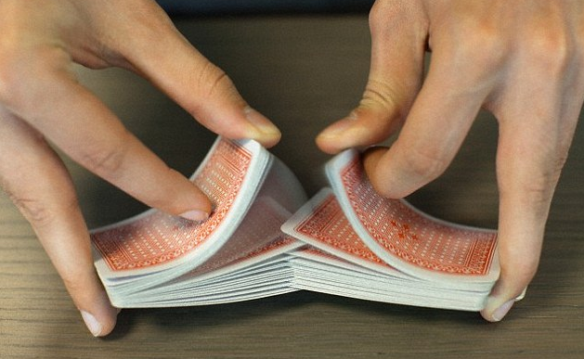



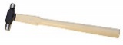
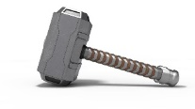





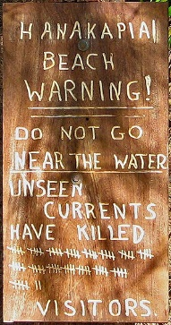


SEPP Forecasting
Phase1
$ 100K (2018)
$ 0 (2019-on)
OP
SYS
Self Calibrating Detectors
Stanford
RIT
U of Az
Earth quake
Purchasing events
Infectious disease
Submarine sightings
Crime events
Artillery launches
Financial transactions
Neuron activity
Terrorist attacks
:
:
Stanford, Penn State, U of FL,
Carnegie Mellon, Rice Univ,
UVA, Georgia Tech, UCLA
U of Queensland
U of Paris, de Corse, Ecole Polytech,
U catholique de Lauvain,
Humbolt U. zu Berlin
Google
photonics
Phase2
$ 0 (2019-on)
Project Status
https://totem.west.ile.X.gov/shares/.view
Brian.d.james@X.gov

Slide 2
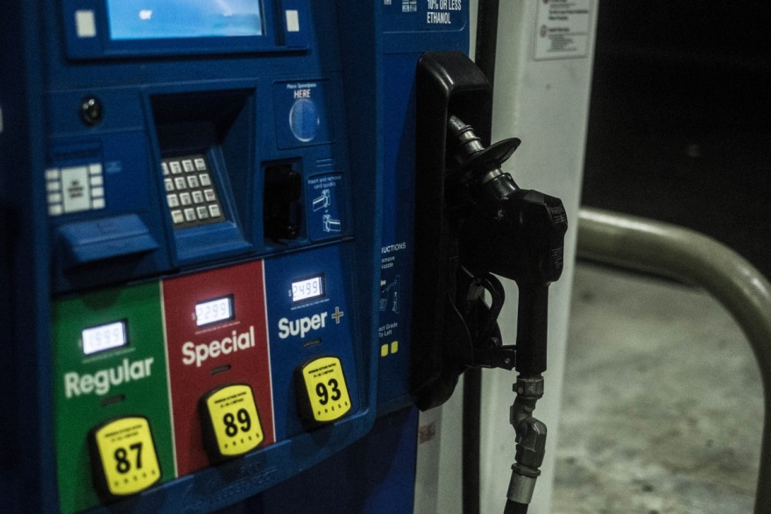



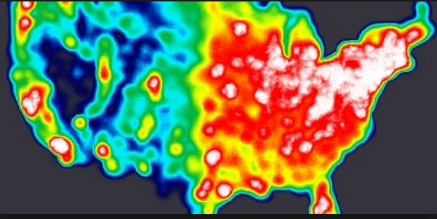


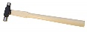

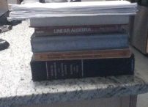
Fuel of unknown quality being pumped into hypothesis engines.
Event Providers (xyzt)
ADSB Airtrack
Overhead IR
ITAR Transactions
Voxel
?
Engine Providers
THRESHER
RGBW Crack Detector
?
?
METRICS
FORECASTS
GEOINT-SYMP
ROC Metrics
COGNOS
Forecasts
OPERATIONAL
∞ VMS ∞ GB
$$$$ 12 HEADs
NEW
TOTEM
SNR Metrics
TOTEM
Forecasts
NON OPERATIONAL
1 VM 20 GB
FREE - NO SUPPORT
OLD
t
Phase1
$ 100K (2018)
$ 0 (2019-on)
Metric Providers
Prof. Mandel, Wilson’s Chair Physic, RIT
Prof. Wolf, Lee DuBridges Chair Physics, RIT
Prof. Frieden, Optical Sci Chair, UofAz
Prof. Goodman, EE Chair, Stanford
Phase2
$ 0 (2020-on)

Slide 3
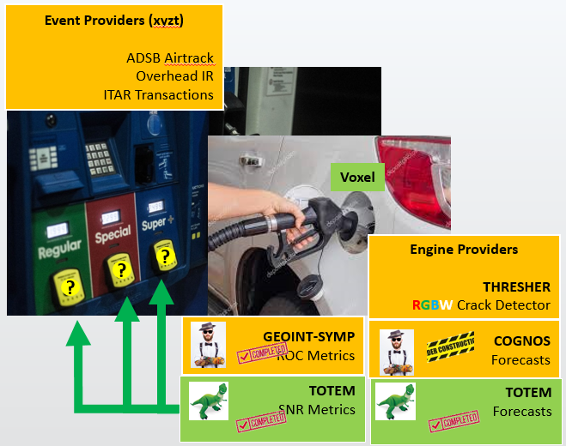
The Art of the Transition

Slide 4
Where’s the GEOINT ?
Reserved for map samples

Slide 5
So what are we doing ?

Slide 6

Supervised ? Unsupervised ?
SEPP
Hidden states
x, y, z, t, state
x, y, z, t
Black Body Calibrated
Self Calibrating Detector
Supervised Learning
Unsupervised Learning

Slide 7
Quiz !
I texted the following to my Wife, my Son, and a Friend ….
Eureka ! I got my Levenberg Marquardt to compute the
correlation times of a Markov process,
thus bypassing a hopeless Linear Factor Analysis that would attempt to
maximizes a Chi^2 fit of a
negative binomial with a differentated Gamma function.
The correct response pattern was RGB ?
I like cheese | Wife | F | S
You misspelled differentiated | Son | S | W
I avoid all that negativity by using positive binomials | Friend | W | F

Slide 8
Self Calibrating Detectors
SEPP Machine Learning

Slide 9
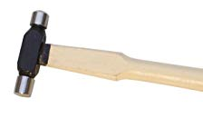

 | 1950 - 1990 Self Calibrated Detectors | Now 1990 – 2000 SEPP Machine Learning
Metrics | Levenberg Marquardt SNR % Complete ETC | 2-Way Contingency ROC
Forecasts | Karhunen Loeve Arrival Rate Paley Weiner Trigger Function Viterbi Decoding Brownian Motion | EM Arrival Rate Space-Time Trigger Function
t

Slide 10

Some Physics of Self Calibrating Detectors
… via a cheap parlor trick
thus any SEPP Forecaster

Slide 11
Are They Related ?
y
x

Slide 12
Still Related ?
Trade
Deficit
National Debt

Slide 13
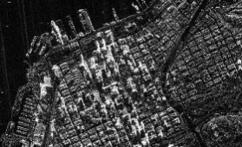
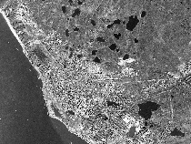


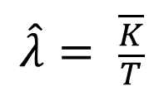
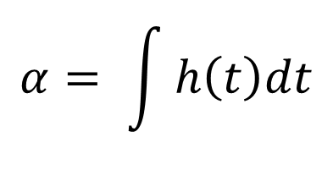
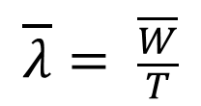
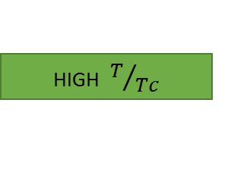
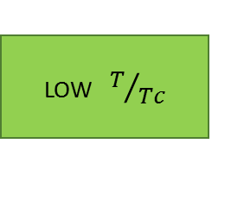
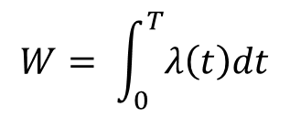
Still Related ??
Output
Observed
LOW $T/{Tc}$
HIGH $T/{Tc}$
High
SNR
$$\hat{λ}= \frac{\overline{K}}{T}$$
LOW
SNR
PWT
K = Observed
Counts
EM
$$α= \int{h\left(t\right)dt}$$
S.F.I.
KL
EM
$$\overline{λ}= \frac{\overline{W}}{T}$$
Input
Forecasted
$$W= \int_{0}^{T}{λ\left(t\right)dt}$$
Integrated Intensity

Slide 14
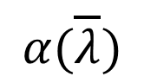
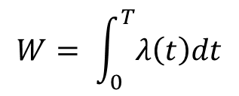
Still Related ???
Output
P.O.L.
$$α(\overline{λ})$$
POL
WSS
SFI
$$\hat{λ}= \frac{\overline{K}}{T}$$
Ergodic
SS
K = Observed
Counts
$$α= \int{h\left(t\right)dt}$$
S.F.I.
$$\overline{λ}= \frac{\overline{W}}{T}$$
Input
$$W= \int_{0}^{T}{λ\left(t\right)dt}$$
Integrated Intensity

Slide 15
GPU-ized Machine Learning
.. some known side effects

Slide 16

Over the last 10 years …
Total energy to run
410 Million GPUs (500 W = 40 $/mth each)
= 2 Trillion USD
= 50% of GDP growth
= 20% of bad Private Sector debt
= 5 x Internet 1.0 Bubble
= cost to feed and house 20 M people
Ref: next slide

Slide 17
h(t)
&
h(t,x)
The Trigger Function
Quantum Computing
voxel network
Brownian motion
Viterbi decoding

Slide 18
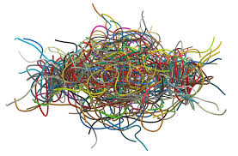

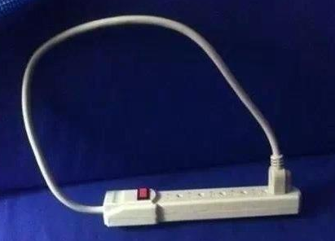
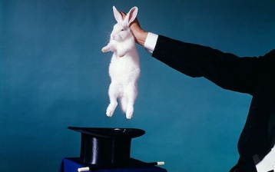
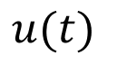
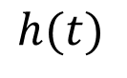
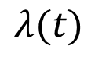
Unknown Trigger
Threshold &
Peak Rate
Circuit
∞ Parameters
Unknown
Arrival Rate
“Uncountable”
count process
$$λ(t)$$
$$h(t)$$
$$u(t)$$
Positive Definite
Always ? Why ?
Infinite power in PSD so
… no Nyquist cutoff
… cant be sampled
… but it can be Fourier transformed !

Slide 19

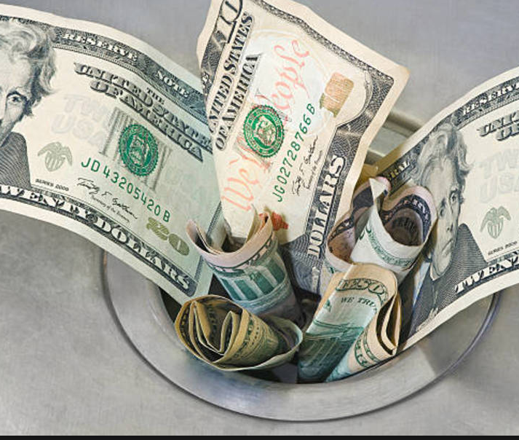


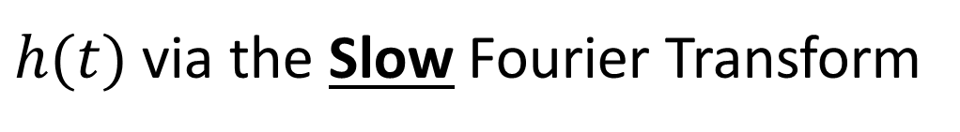
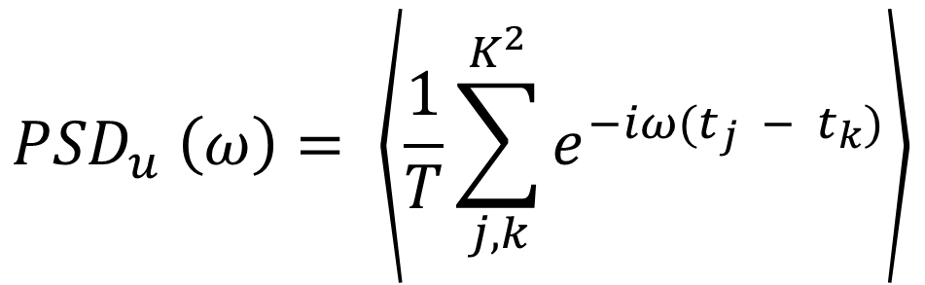
Hi
$h(t)$ via the Slow Fourier Transform
You again
$${PSD}_{u} \left(ω\right)= \left\langle \frac{1}{T}\sum_{j,k}^{K^{2}}{e^{−iω(t_{j} − t_{k})}}\right\rangle$$
PWT
This is the “DNN” we need to learn
Unsupervised Learner … but needs “unique events ids”
Slooooow FT ➔ Faster FT when GPU-ized

Slide 20
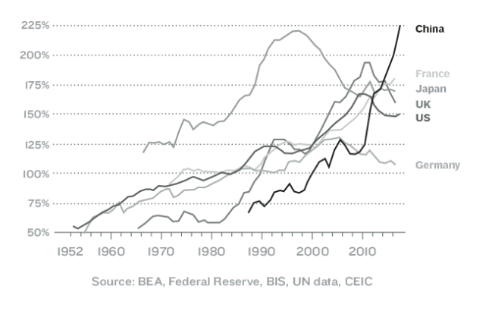
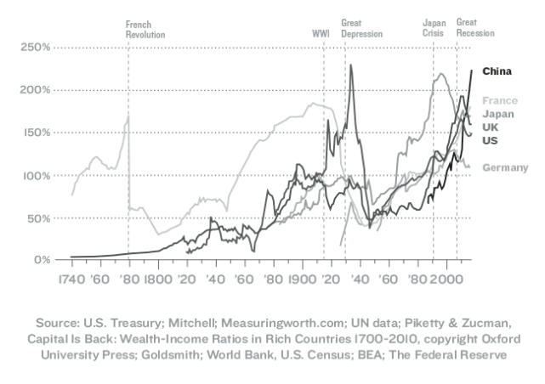

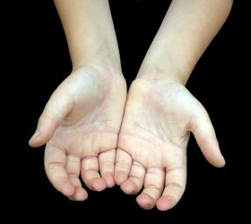



Private Sector Debt to GDP
Google/R - Carnegie Mellon
Revisiting Unreasonable
Effectiveness in the
Deep Learning Era
Internet 1.0
Bubble
2 T USD
Internet 2.0
Bubble
10 T USD

Slide 21
Questions ?

